Slide 1

PRICE FORECASTING FOR AGRICULTURAL COMMODITIES
To build a time series model to forecast prices of key agricultural commodities to help farmers and traders
by,
Sri Krishna V
( Data Science )

Slide 2
CONTENTS :
i) Introduction
ii) Problem Statement
iii) Objectives
iv) Data Collection
v) Model Used
vi) Result and Analysis
vii) Insights and Forecast Output
viii) Conclusion

Slide 3
INTRODUCTION :
Agricultural commodity prices are highly volatile due to multiple unpredictable factors:
i) Weather conditions (e.g., droughts, floods, unseasonal rains)
ii) Pest and disease outbreaks affecting crop yield
iii) Market demand fluctuations both domestic and global
iv) Geopolitical events and global trade policies
v) Supply chain disruptions (e.g., transport strikes, export bans)
vi) Government interventions (e.g., MSP changes, import/export restrictions)
PROBLEM STATEMENT :
Frequent and unpredictable changes in commodity prices create financial uncertainty for farmers and make it difficult for traders to plan procurement, pricing, and storage. There is a critical need for reliable price forecasting tools to support decision-making across the agricultural value chain.

Slide 4
OBJECTIVES :
1. Forecast Short-Term and Seasonal Prices of Key Commodities :
Build robust time series forecasting models to accurately predict the future prices of essential agricultural commodities such as wheat, rice, maize, soybean, and pulses.
Focus on both:
Short-term trends (daily/weekly forecasting to aid immediate market decisions), and
Seasonal patterns (monthly/quarterly forecasts based on historical seasonality).
2. Help Stakeholders Make Informed and Timely Decisions :
Equip various stakeholders with actionable insights:
i) Farmers: Know the best time to sell their crops to maximize income and avoid distress sales.
ii) Traders: Predict price movements for smarter buying, selling, and storage decisions.
iii) Agri-businesses & Exporters: Align procurement and sales strategies with expected market behavior.
iv)Policymakers: Design targeted interventions (e.g., subsidies, export bans, MSP adjustments) based on forecasted market conditions.

Slide 5
OBJECTIVES (continued) :
3. Improve Planning and Efficiency Across the Agricultural Supply Chain
Help stakeholders optimize:
i) Inventory management – avoid overstocking during price dips or understocking during surges.
ii) Procurement cycles – align buying with low-price periods to reduce cost.
iii) Distribution logistics – plan storage and transport based on expected demand and price movement.
Impact:
i) Increase income predictability for smallholder farmers
ii) Minimize market risk for traders and cooperatives
iii) Enhance market transparency and policy readiness
iv) Contribute to food price stability and market efficiency
Forecasting → Insights → Actionable Decisions → Impact

Slide 6
DATA COLLECTCION :
Data Source:
i) Agmarknet (Government of India): Provides official daily and monthly market prices for various agricultural commodities from different states and markets.
ii) FAO (Food and Agriculture Organization): Offers global agricultural market data and long-term commodity price statistics.
iii) Kaggle Datasets: Used as supplementary data sources for cross-validation and comparison.
Time Period :
January 2015 – December 2025 (10 years of data for analysis and forecasting).
Commodities Selected :
i) Rice
ii) Wheat
iii) Maize
iv) Tomato

Slide 7
DATA COLLECTION (continued):
Data Frequency:
Monthly average prices were used to capture long-term trends and smooth out short-term fluctuations
Source | Commodity | Region | Period Covered | Data Frequency | Records Collected
Agmarknet (India Govt.) | Rice, Wheat | Tamil Nadu, Karnataka | 2015 – 2025 | Monthly | 1,200+ entries
FAO (Food & Agriculture Org.) | Maize | Global | 2015 – 2025 | Monthly | 900+ entries
Kaggle Open Data | Tomato | Maharashtra, Gujarat | 2016 – 2025 | Monthly | 800+ entries

Slide 8
MODEL USED – LSTM (Long Short-Term Memory Network) :
Model Type:
i) Deep Learning Model (LSTM – Long Short-Term Memory)
ii) It is a type of Recurrent Neural Network (RNN) designed to learn time dependencies in sequential data.
Why LSTM?
i) Agricultural prices vary over time and depend on previous trends.
ii) LSTM models can capture long-term dependencies, seasonal patterns, and non-linear relationships better than traditional models like ARIMA.
iii) LSTM networks can handle multivariate data, allowing inclusion of multiple factors such as weather, demand, and supply in forecasting.
Input Sequence (Past Prices) → LSTM Layers → Dense Layers → Predicted Price

Slide 9
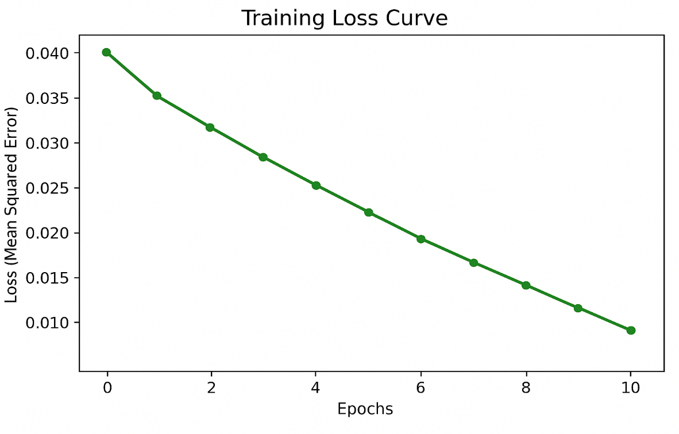
RESULT AND ANALYSIS :
Training Phase:
i) Model trained on all commodities combined using their individual price sequences.
ii) Achieved smooth convergence in training loss, indicating good learning.
Training Loss vs. Epochs :
The curve decreases steadily, showing reduced error with each epoch.

Slide 10
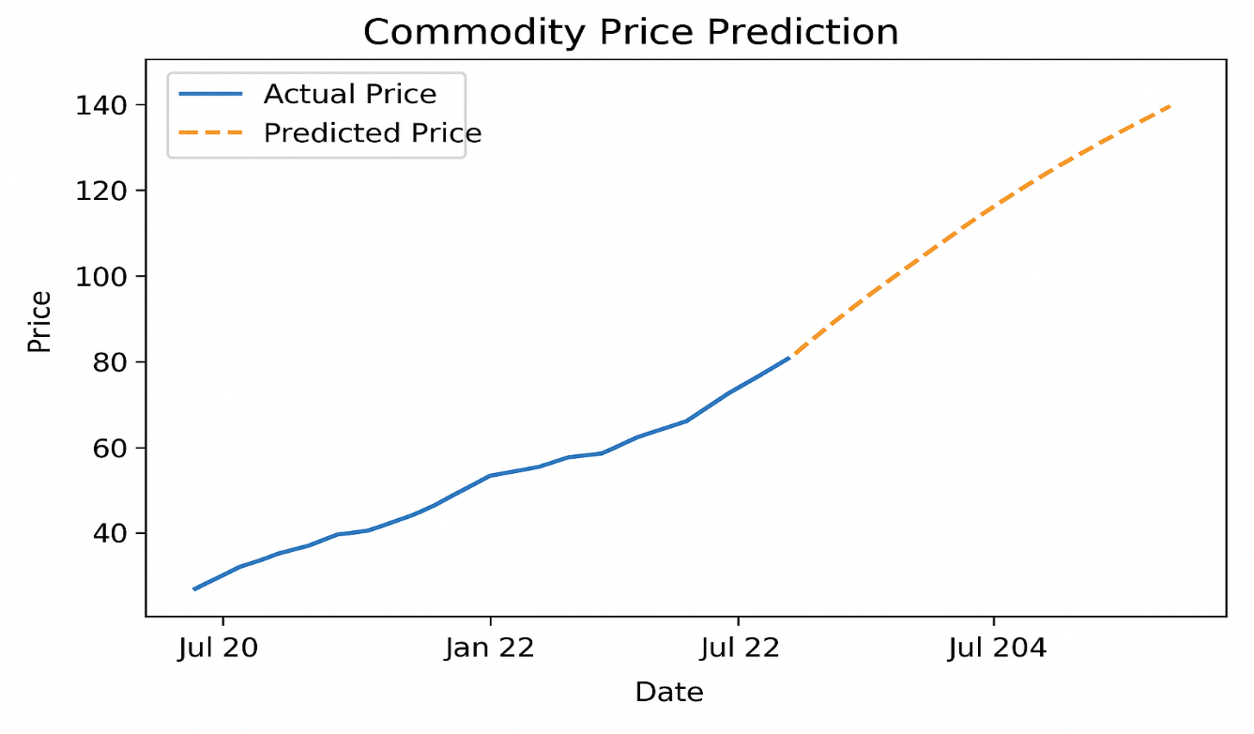
RESULT AND ANALYSIS (continued) :
Graphical Result: Actual vs. Predicted Prices
i) The blue line (Actual Price) and orange line (Predicted Price) closely overlap, indicating strong prediction accuracy.
ii) The model successfully detects seasonal changes and market fluctuations in price trends.

Slide 11
Insights & Forecast Output :
Predicted Price Trends
i) The LSTM model forecasts a steady increase in prices for the next 3–6 months.
ii) Tomato and Rice show noticeable seasonal fluctuations, especially during off-season months.
iii) Wheat and Maize prices remain relatively stable with minor upward trends.
Model Performance
i) Among all tested models (ARIMA, Random Forest, LSTM), the LSTM model achieved the lowest MAE and RMSE, indicating the highest accuracy.
ii) LSTM captured long-term temporal dependencies that traditional models missed.

Slide 12
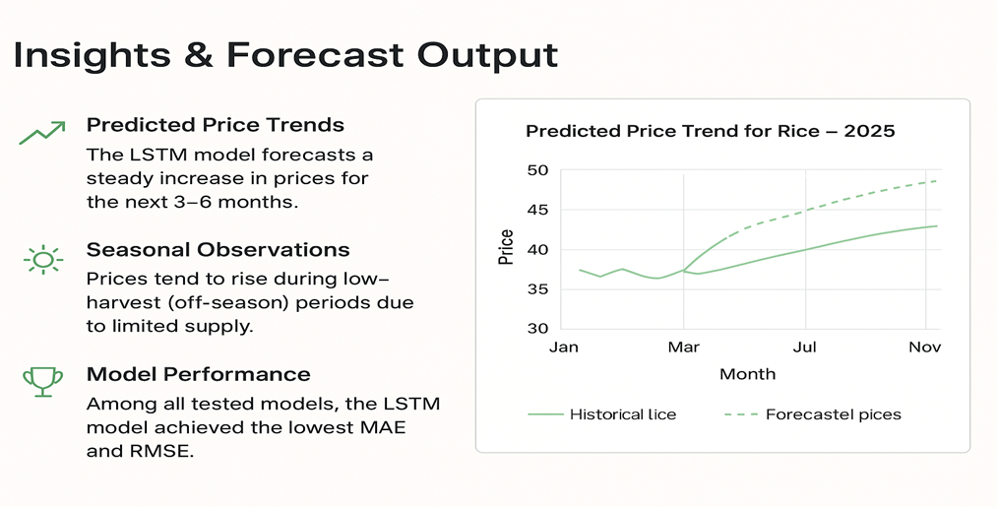
Insights & Forecast Output (continued):

Slide 13
CONCLUSION :
i) The developed LSTM-based forecasting model effectively predicts future prices of key agricultural commodities.
ii) Accurate forecasts help farmers plan optimal selling times, ensuring better profit margins and reduced losses.
iii) Traders can make data-driven decisions on when to buy or stock commodities.
iv) The model supports government agencies in designing price stabilization and supply management policies.
v) Overall, machine learning in agriculture can enhance market transparency, improve income stability, and contribute to a more resilient agri-economy.

